Slide 1
Chapter 12: Physical Storage Systems
Notes:
数据持久存放于以磁盘为代表的存储设备中，处理时需读入主存。磁盘和主存之间存在着巨大的访问速度鸿沟。讲授以块为单位的内外存数据传输、缓冲区管理与替换策略、记录在块中的存放方式，以及数据文件组织的主要形式

Slide 2
Classification of Physical Storage Media
Can differentiate storage into:
  volatile storage(易失存储): loses contents when power is switched off
  non-volatile storage（非易失存储）:
    Contents persist even when power is switched off.
    Includes secondary and tertiary storage, as well as batter- backed up main-memory.
Speed with which data can be accessed
Cost per unit of data
Reliability
  data loss on power failure or system crash
  physical failure of the storage device

Slide 3
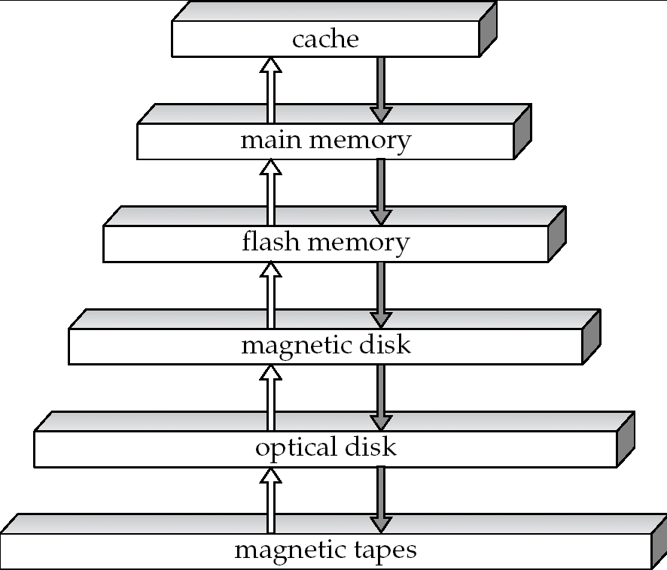
Storage Hierarchy（存储级别）
!!!
~ 1 ns
primary
storage
(一级存储)
volatile
storage
（易失存储）
!!!
~10² ns
NVM
secondary
storage
(二级存储 online
storage)
SSD也非易失
!!!
~10⁷ ns
non-volatile
storage
（非易失存储）
tertiary
storage
(三级存储
offline
storage)

Slide 4

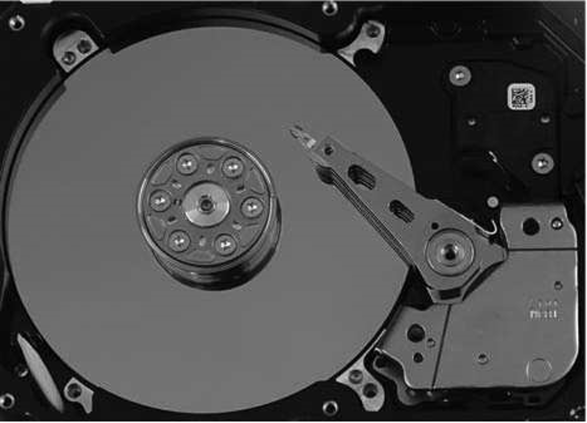
Magnetic Hard Disk Mechanism
Simplified Diagram of Disk Drives
Photo of magnetic disk drive

Slide 5
Magnetic Disks
Read-write head 读写头
  Positioned very close to the platter surface (almost touching it)
  Reads or writes magnetically encoded information.
Surface of platter divided into circular tracks（磁道）
  Over 50K-100K tracks per platter on typical hard disks
Each track is divided into sectors（扇区）. 外面圆大一点，扇区大一点
  A sector is the smallest unit of data that can be read or written.
  Sector size typically 512 bytes
  Typical sectors per track: 500 to 1000 (on inner tracks) to 1000 to 2000 (on outer tracks)
To read/write a sector
  disk arm swings to position head on right track
  platter spins continually; data is read/written as sector passes under head
Head-disk assemblies
  multiple disk platters on a single spindle (1 to 5 usually)
  one head per platter, mounted on a common arm.
Cylinder（柱面） i consists of i^{th} track of all the platters 存在一个柱面可以并行读，加快读的速度

Slide 6

Magnetic Disks (Cont.)
Disk controller(磁盘控制器) – interfaces between the computer system and the disk drive hardware.
  accepts high-level commands to read or write a sector
  initiates actions such as moving the disk arm to the right track and actually reading or writing the data
  Computes and attaches checksums to each sector to verify that data is read back correctly
    If data is corrupted, with very high probability stored checksum won’t match recomputed checksum
  Ensures successful writing by reading back sector after writing it
  Performs remapping of bad sectors

Slide 7
Performance Measures of Disks
Access time(访问时间) – the time it takes from when a read or write request is issued to when data transfer begins. Consists of:
  Seek time（寻道时间） – time it takes to reposition the arm over the correct track.
    Average seek time is 1/2 the worst case seek time.
    4 to 10 milliseconds 毫秒 on typical disks
  Rotational latency （旋转延迟）– time it takes for the sector to be accessed to appear under the head.
    Average latency is 1/2 of the worst case latency.
    4 to 11 milliseconds on typical disks (5400 to 15000 r.p.m.)
Data-transfer rate（数据传输率） – the rate at which data can be retrieved from or stored to the disk.
  25 to 100 MB per second max rate, lower for inner tracks
  Multiple disks may share a controller, so rate that controller can handle is also important
    E.g. SATA: 150 MB/sec, SATA-II 3Gb (300 MB/sec)
    Ultra 320 SCSI: 320 MB/s, SAS (3 to 6 Gb/sec)
    Fiber Channel (FC2Gb or 4Gb): 256 to 512 MB/s

Slide 8
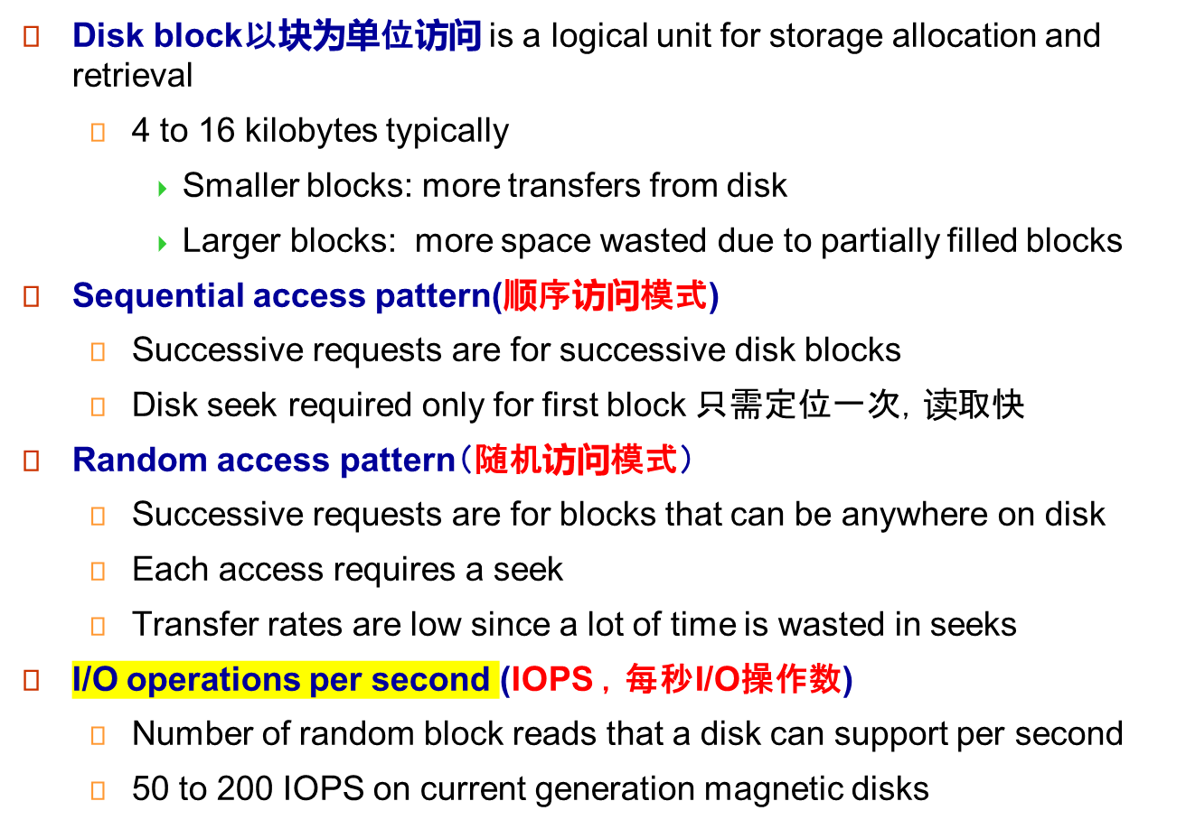
Performance Measures of Disks（Cont.）

Slide 9
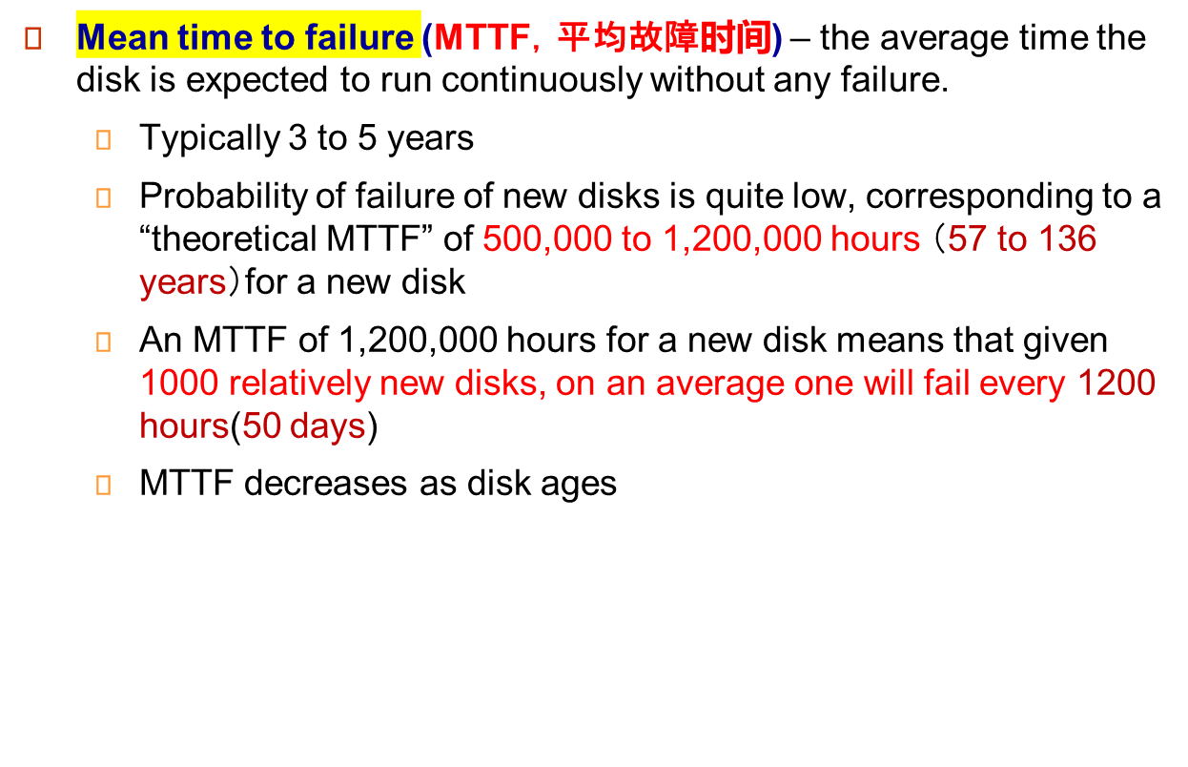
Performance Measures (Cont.)

Slide 10
Optimization of Disk-Block Access
Buffering缓存: in-memory buffer to cache disk blocks
Read-ahead(Prefetch)预取: Read extra blocks from a track in anticipation that they will be requested soon
Disk-arm-scheduling algorithms re-order block requests so that disk arm movement is minimized
  elevator algorithm电梯算法
R6
R3
R1
R5
R2
R4
Inner track
Outer track

Slide 11
Optimization of Disk Block Access (Cont.)
File organization文件结构
  Allocate blocks of a file in as contiguous a manner as possible
  Allocation in units of extents(盘区）
  Files may get fragmented
    E.g., if free blocks on disk are scattered, and newly created file has its blocks scattered over the disk
    Sequential access to a fragmented file results in increased disk arm movement
    Some systems have utilities to defragment反碎片化 the file system, in order to speed up file access 把碎片整理

Slide 12
Read-Block Access (Cont.)
Nonvolatile write buffers （非易失性写缓存） – speed up disk writes by writing blocks to a non-volatile RAM buffer immediately
  Non-volatile RAM: battery backed up RAM or flash memory
    Even if power fails, the data is safe and will be written to disk when power returns
  Controller then writes to disk whenever the disk has no other requests or request has been pending for some time
  Database operations that require data to be safely stored before continuing can continue without waiting for data to be written to disk
  Writes can be reordered to minimize disk arm movement
Log disk（日志磁盘） – a disk devoted to writing a sequential log of block updates
  Used exactly like nonvolatile RAM
    Write to log disk is very fast since no seeks are required
    No need for special hardware (NV-RAM)
    可以把随机访问转换为顺序访问，加速

Slide 13
Flash Storage （SSD固态）
NAND flash - used widely for storage, cheaper than NOR flash
  requires page-at-a-time read 按页访问 (page: 512 bytes to 4 KB)
    Not much difference between sequential and random read
  Page can only be written once
    Must be erased to allow rewrite
SSD(Solid State Disks)
  Use standard block-oriented disk interfaces, but store data on multiple flash storage devices internally （SSD比磁盘快得多）
 | Magnetic Disk | Solid State Disk
Retrieve a page | 5-10 milliseconds 毫秒 | 20-100 microseconds 微秒
Random access | Random 50 to 200 IOPS | reads: 10,000 IOPS writes: 40,000 IOPS
Data transfer rate | 200M | 500M(SATA), 3G(NVMe)
Power consumption | higher | lower
Update mode | in place | erase → rewrite
Realiability | MTTF : 500,000 to 1,200,000 hours | erase blocks: 100,000 to 1,000,000 erases
Notes:
这里开始的三页似乎都是sjl自己加的

Slide 14
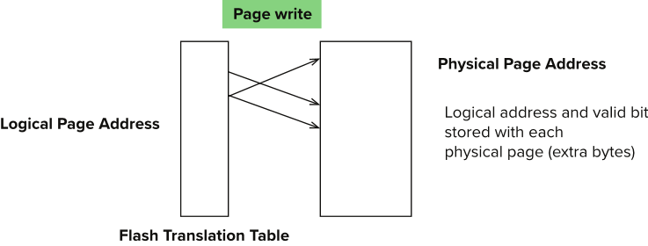
Flash Storage (Cont.)
Erase happens in units of erase block
  Takes 2 to 5 milliseconds
  Erase block typically 256 KB to 1 MB (128 to 256 pages)
  After 100,000 to 1,000,000 erases, erase block becomes unreliable and cannot be used
Remapping of logical page addresses to physical page addresses avoids waiting for erase
Flash translation table tracks mapping
  also stored in a label field of flash page
  remapping carried out by flash translation layer
wear leveling(磨损均衡)- evenly distributed erase operators across physical blocks
物理地址
逻辑地址
Notes:
Where is FTL stored? How is it reconstructed on system startup?
How to track number of erases per block (extra storage per block)
SSD放的物理地址可以映射，可以放不容易磨损的地方。SSD的逻辑地址不变

Slide 15
Storage Class Memory(NVM)
3D-XPoint memory technology pioneered by Intel
Available as Intel Optane
  SSD interface shipped from 2017
    Allows lower latency than flash SSDs
  Non-volatile memory interface announced in 2018
    Supports direct access to words, at speeds comparable to main-memory speeds
一般写都要比读慢，因为写还要检验是否写入
 | DRAM | NVM | SSD | HDD
Read Latency | １x | ２－４ｘ | 500x | 10⁵ x
Write Latency | １x | ２－８ｘ | 5000x | 10⁵ x
Persistence | No | Yes | Yes | Yes
Byte-Addressable | Yes | Yes | No | No
Endurance | Yes | No | No | Yes
非轶失
按Block

